Slide 1



A Practical Introduction to Analysing Complex Social Survey Data
Vernon Gayle University of Edinburgh vernon.gayle@ed.ac.uk @profbigvern | Roxanne Connelly University of Warwick r.connelly@warwick.ac.uk @ConnellyRoxanne
An output from the project ‘Have Socio-Economic Inequalities in Childhood Cognitive Test Scores Changed?
A Secondary Analysis of Three British Birth Cohorts’
Funded by the ESRC Secondary Data Analysis Initiative https://tinyurl.com/h3nj59b

Slide 2
Part 0 Welcome

Slide 3
Complex Social Surveys
You might never conduct a complex survey…
You might never analyse a complex survey dataset…
But you may need to read results from the analysis of complex social survey and therefore wish to understand more

Slide 4

Large Facilities Capital Fund

Slide 5
Complex Social Surveys
Large in scale (n = big)
Nationally representative
Support analyses of subpopulations
Multipurpose (omnibus)
Many data files
A large number of measures (n = big)
Longitudinal data has repeated contacts (t₁, t₂, t₃)

Slide 6
Complex Social Surveys Good Points
Multipurpose (omnibus)
Nationally representative
Support analyses of subpopulations
Support analysis of social change / social stability

Slide 7
Complex Social Surveys Less Good Points
Designs are complex
Selection and sampling strategies complex
Dealing with many files
Matching individual records over time
Linking records (spouses, households, siblings, regional info)
Making sense of measures over time (e.g. qualifications, neighbourhoods)

Slide 8
Prelude
Gayle and Lambert (2006)
Over the decades a virtual industry producing critiques of survey analyses from various standpoints has developed. We suggest that arguments for and against the analysis of data from social surveys, have at times resembled a caricature not dissimilar to the Shakespearean feud between the Montagues and the Capulets.

Slide 9
Prelude
Gayle and Lambert (2006)
Goldthorpe (2000) notes that critics of survey based social science research ritually characterise it as static and this is simply to ignore the rapid development of survey related work.
Far from remaining static in their practices, survey researchers in social science have been reflexive and have attempted to respond to various critiques and specific shortcomings that have been highlighted.
These responses have usually involved improving statistical techniques of variable analysis, and improving the underlying data quality.
http://www.restore.ac.uk/Longitudinal/wp/lda_2006_3.pdf

Slide 10
Part 0 Revision (terminology etc)

Slide 11
The Social Survey
Think of this as a data collection approach rather than a single technique
A common set of
‘systematic’ measures (variables) are collected on a set of cases

Slide 12
Cases
Entities such as….
Individuals, households and families

Slide 13
Cases
Entities such as….
Individuals, households and families
Pupils, graduates, ageing citizens
Organisations, schools, firms, farms (or even police stations)
Neighbourhoods, counties, states, regions, countries

Slide 14
Variables
Systematic measures

Slide 15
Variables
Systematic measures
Outcome measures (Dependent Variables, DV, Y variable)
life satisfaction, age at death

Slide 16
Variables
Systematic measures
Outcome measures (Dependent Variables, DV, Y variable)
life satisfaction, age at death
Explanatory measures (Independent Variables, IV, X variable)
gender, occupation, ethnicity

Slide 17
Variables
Be mindful…
In one analysis level of education might be an outcome
In another analysis level of education might be an explanatory variable

Slide 18
Explanatory variable
e
Outcome
e

Slide 19
Explanatory variable 1
e
Outcome
e
Explanatory variable 2
e
Explanatory variable k
e

Slide 20
The Variable by Case Matrix
 | Columns of Variables
 | ID | Age | Gender | Ethnicity
Rows of Cases
1
2
3
n

Slide 21
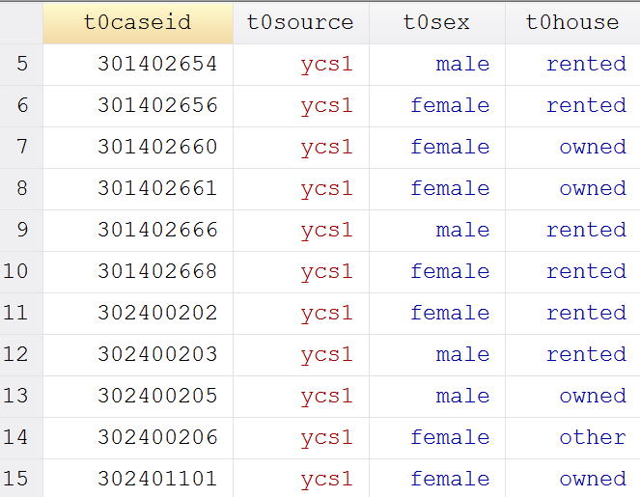

Slide 22
Part 0 UK SURVEYS

Slide 23

Major UK surveys
Government surveys
Opinion polls
Historical data
Qualitative data

Slide 24
Birth Cohort Studies
Longitudinal i.e. repeated contacts with same individuals
Principally concerned with charting the development of the ‘group’ from a certain point in time
Data collected by parental interview early in life
Data collected from the cohort member later (e.g. childhood onwards)

Slide 25
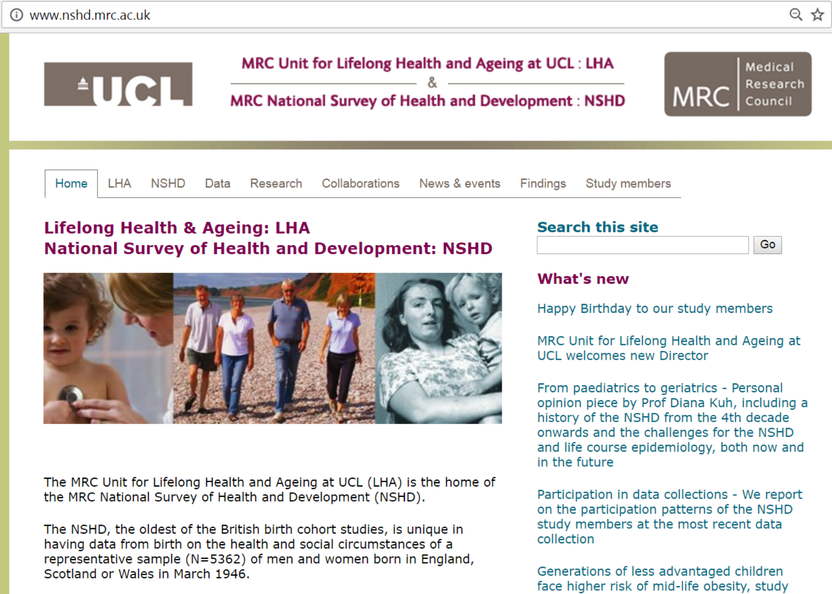

Slide 26
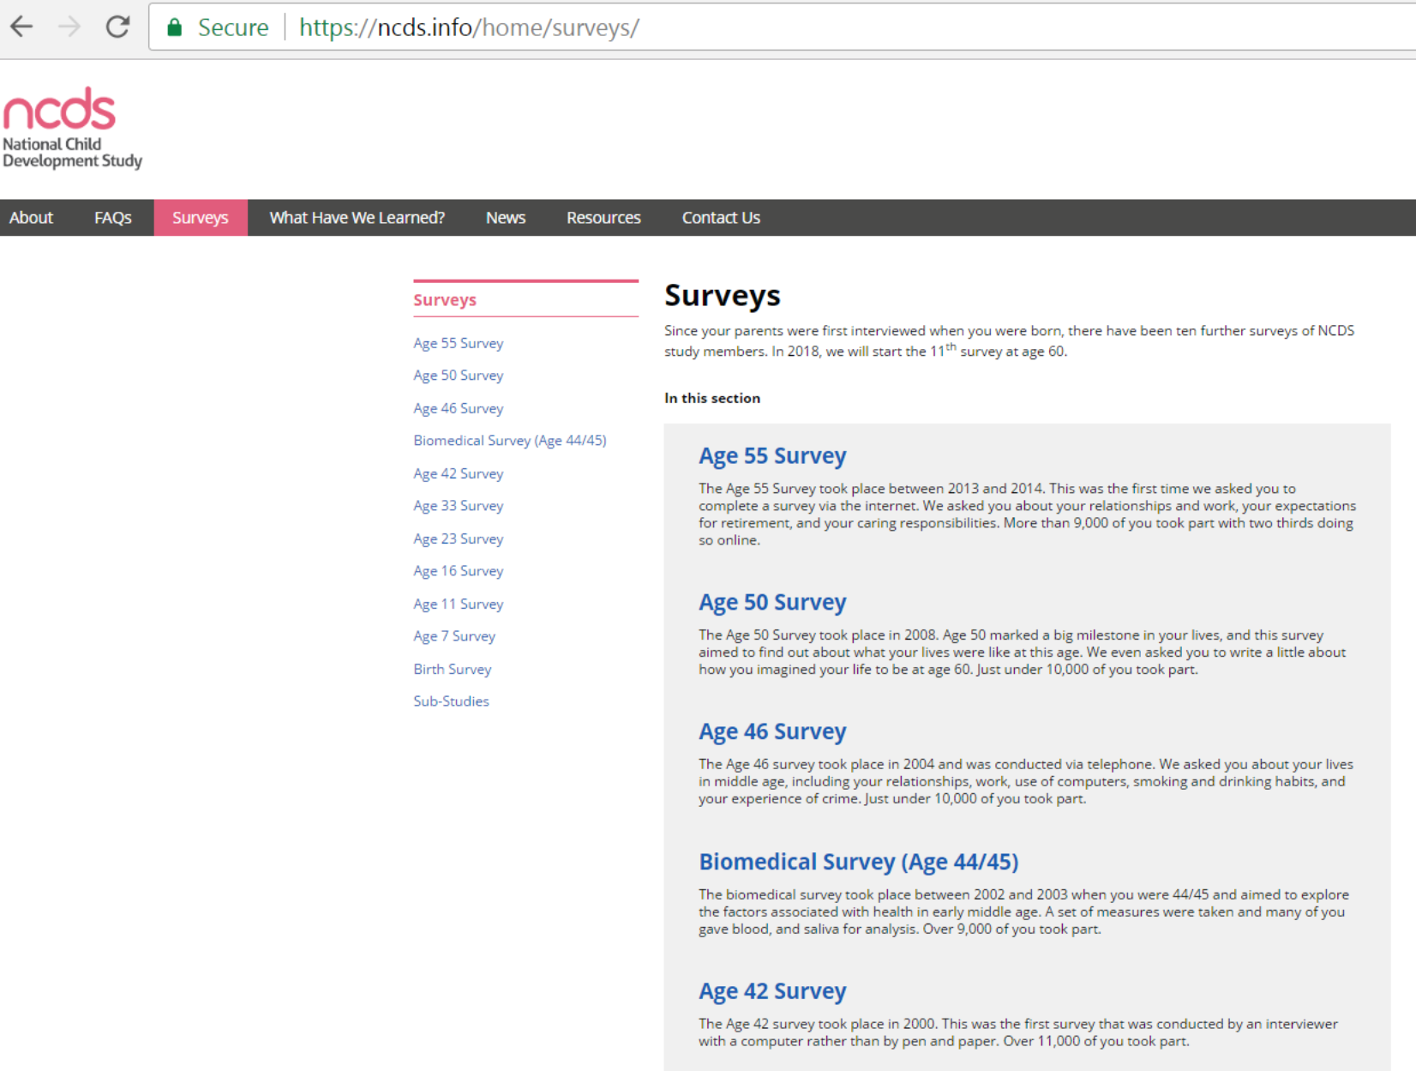

Slide 27
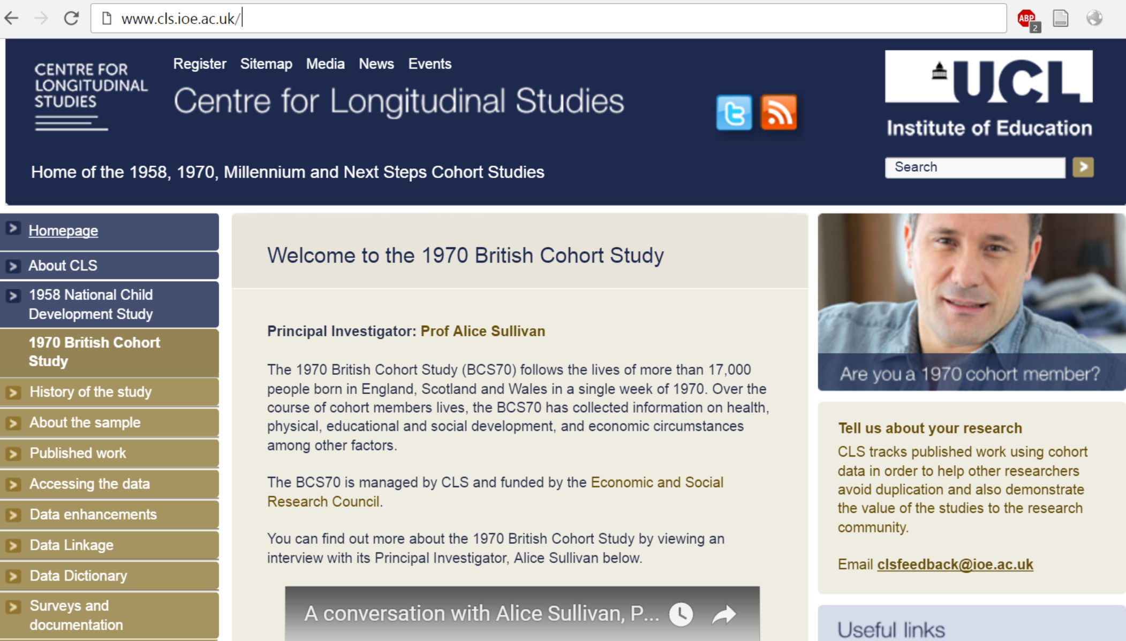

Slide 28

https://youtu.be/sZ4W-5iEMKM

Slide 29


Slide 30

https://www.youtube.com/watch?v=GTD9aDWdwHg

Slide 31


Slide 32
Household Panels
Longitudinal i.e. repeated contacts with same individuals
The ‘panel’ of respondents are followed through time
Surveyed (e.g. interviewed) regularly (e.g. each year)

Slide 33
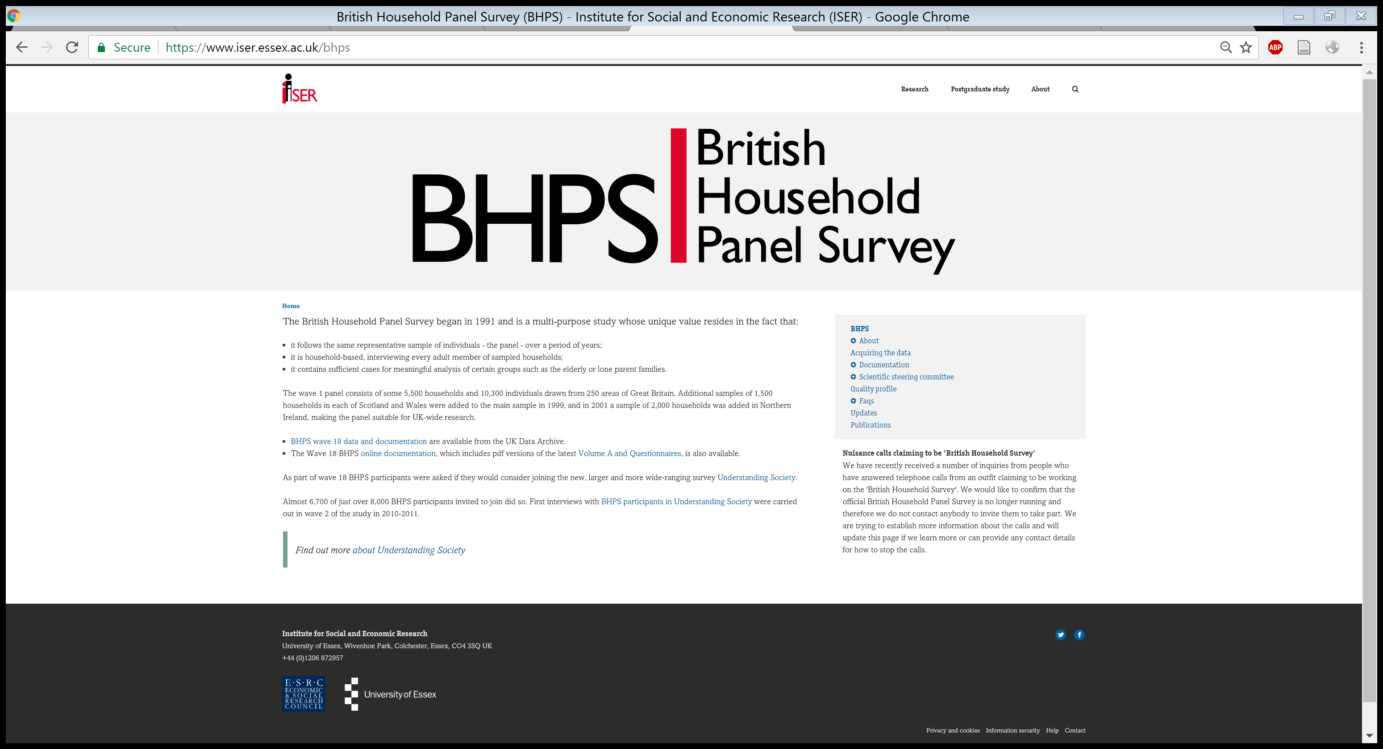

Slide 34
BHPS Structure
Longitudinal study (repeated contacts with same individuals)
Began in 1991
Multipurpose (or omnibus) survey
Data suitable for investigating a wide range of research questions
Core set of questions & rotating modules of questions

Slide 35
BHPS Data Collection
Interviews
Annual (usually in the autumn)
Wave A 1991 through to Wave R 2008
All members of sampled households aged sixteen plus
Forty-five minute interview
Short household questionnaire (one member)

Slide 36
BHPS Topics
housing composition
housing conditions
residential mobility
education and training
health and the use of health services
labour market behaviour
socio-economic values
income from employment, benefits and pensions

Slide 37
BHPS Topics
New questions were sometime introduced and they often followed on from changing policies and changing research agendas
Variable component has included questions on wealth and assets, additional health measures, ageing in retirement, quality of life, children and parenting, views on crime and neighbourhood and social networks
Buck et al. (1994) showcase the wide range of topics that can be analysed using BHPS data

Slide 38
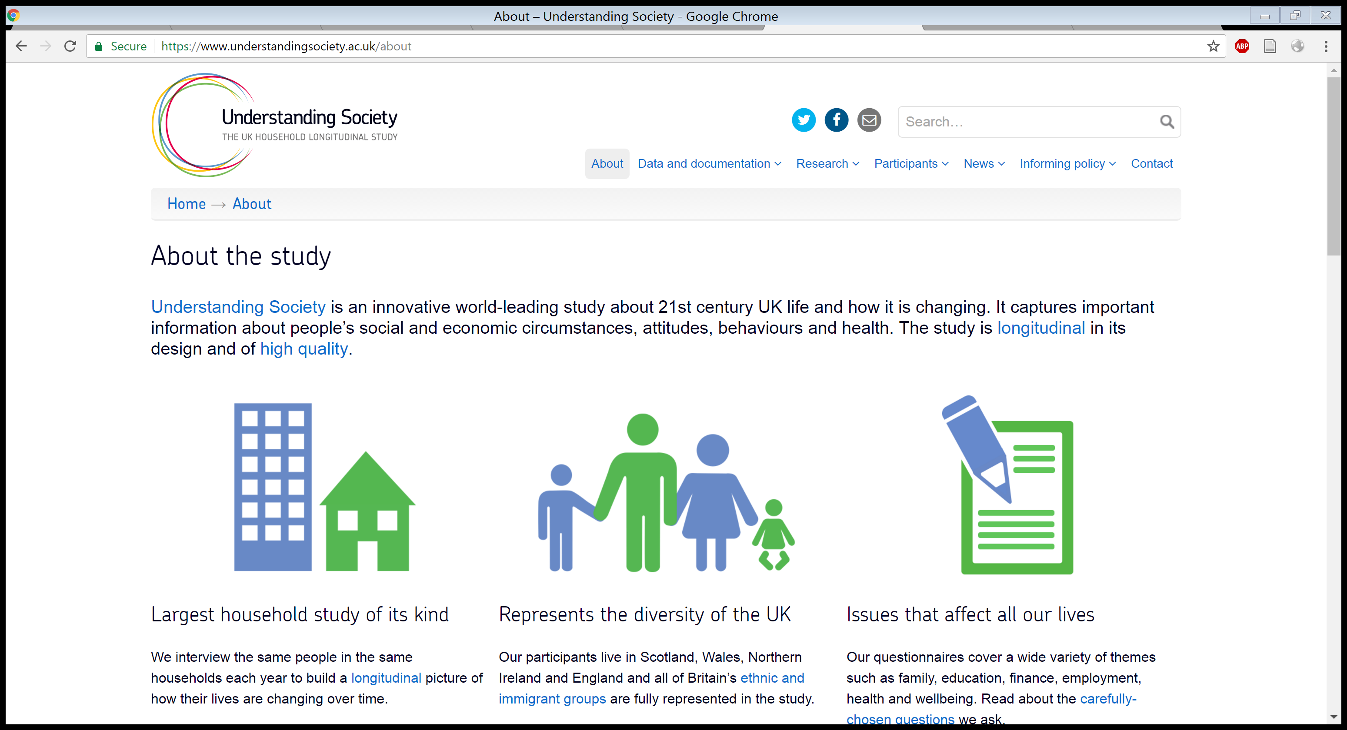

Slide 39
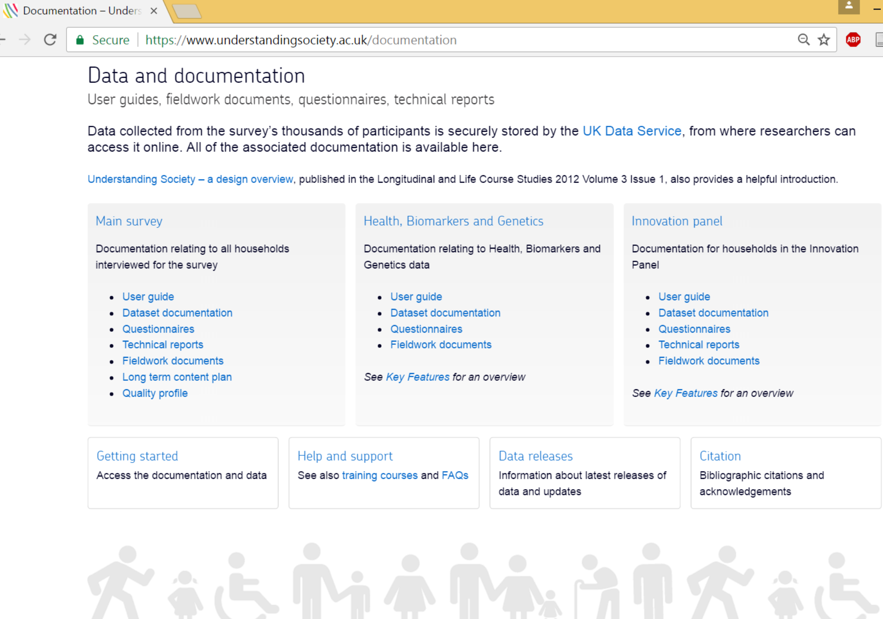

Slide 40
Understanding Society – The UK Household Longitudinal Study (UKHLS)
Largest household panel survey in the world
UKHLS shares common design and data collection characteristics with the BHPS
Began in January 2009
Approximately 40,000 UK households
The UKHLS is available from the UK Data Archive (Study Number 6614)

Slide 41
Understanding Society – The UK Household Longitudinal Study (UKHLS)
Approximately
General population survey 26,000 households
Ethnic minorities boost sample 4,000 households
BHPS 8,400 households
Innovation Panel 1,500 household

Slide 42
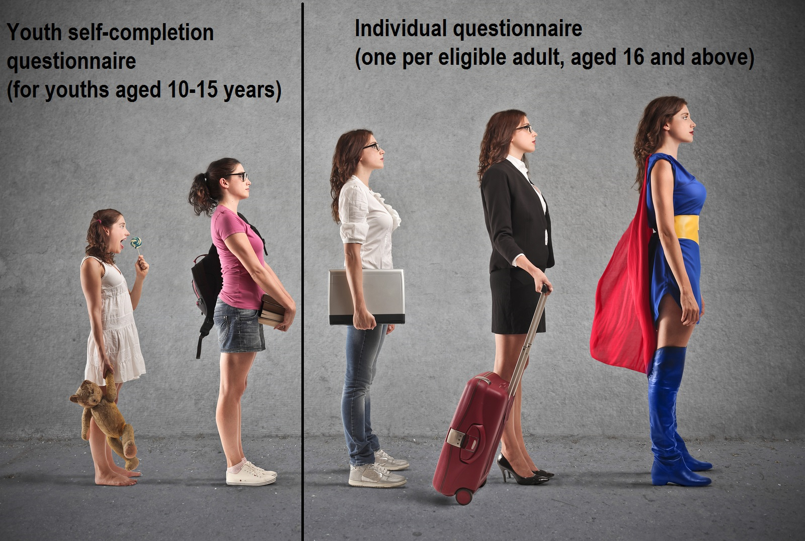

Slide 43
Part 0 Study Designs

Slide 44
A Census
A survey of an ‘entire’ or complete population (n=all)
In the UK the Decennial Census

Slide 45
A Census
A survey of an ‘entire’ or complete population (n=all)
In the UK the Decennial Census
Began in 1801 every 10 years (except 1941)
1911 Boycott - Emily Wilding Davison was sustained by meat lozenges and lime juice as she hid in a broom cupboard in the Houses of Parliament
http://www.theguardian.com/lifeandstyle/2011/apr/01/suffragettes-census-1911-boycott

Slide 46
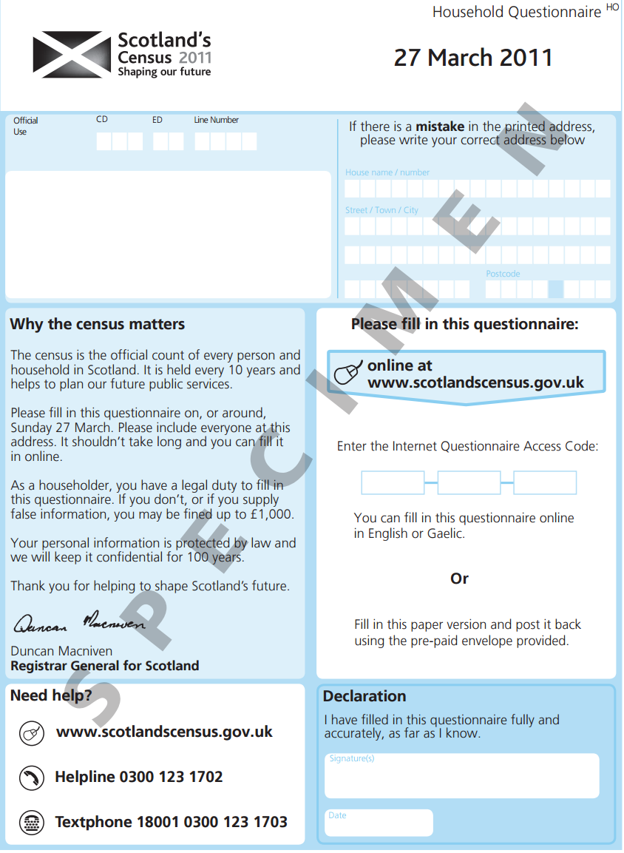

Slide 47
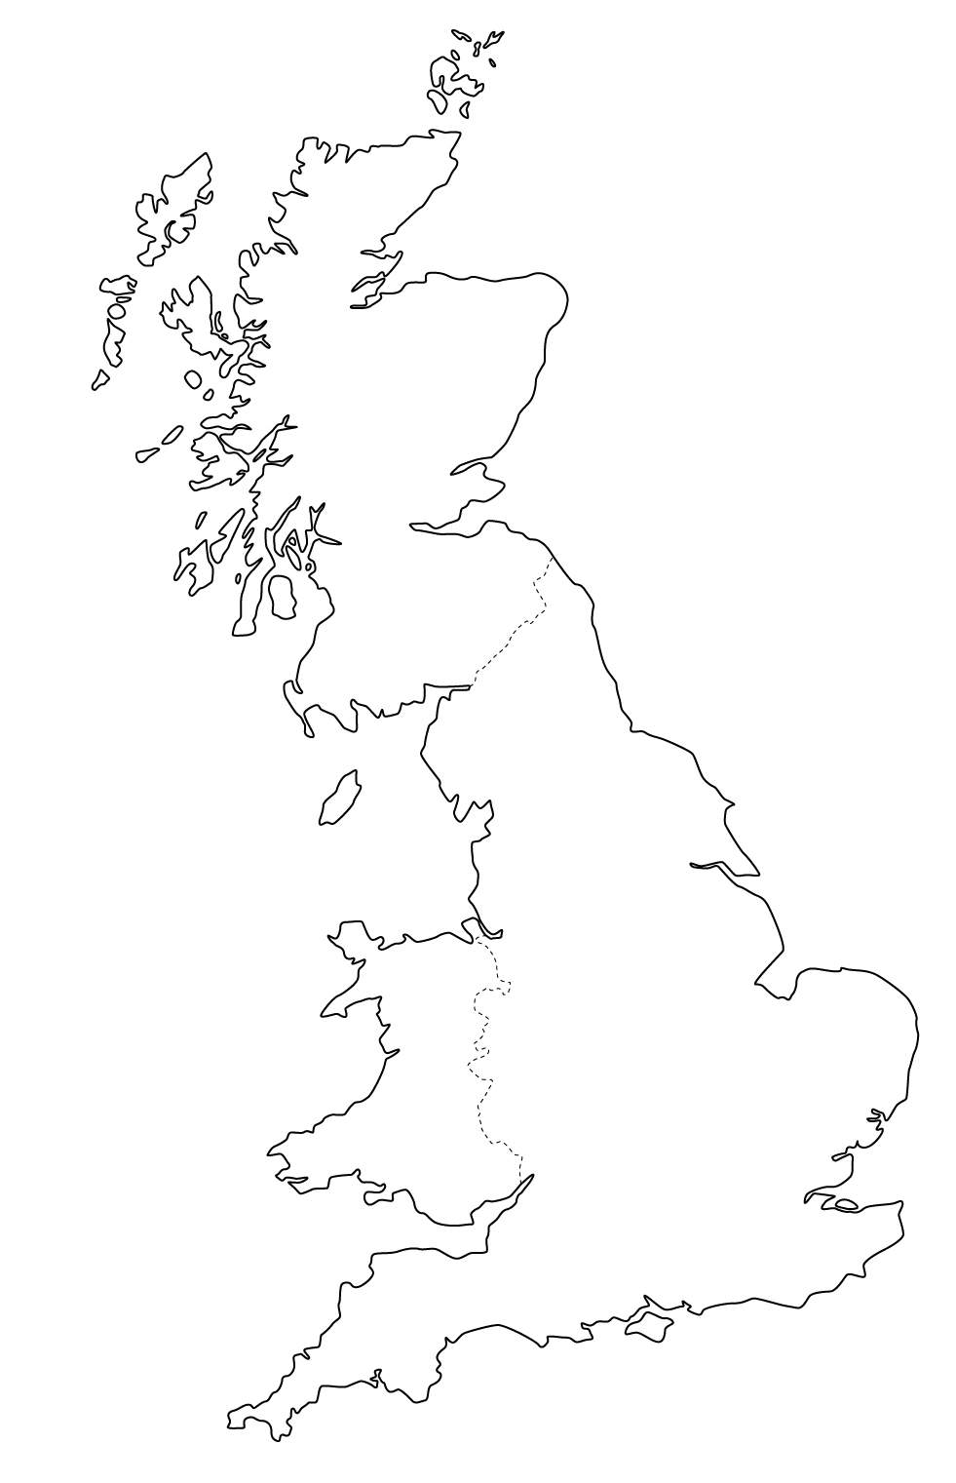

Population
Sample

Slide 48
A ‘Sample’ Survey
Collects information on a ‘sample’ or sub-set of the population
Early examples include…
Charles Booth Survey into life and labour of the people in London (1886-1903)
Seebohm Rowntree Study of York (1899, 1935, 1951)

Slide 49
Selecting Samples

Slide 50
Non-Probability Samples
DO NOT have a formal statistically informed method of selecting cases
Are NOT statistically representative of the population of study (but might be sociologically informative)

Slide 51
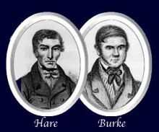
Non-Probability Samples
The Great British Class Survey was carried out online
It was widely publicized by the BBC, and completed by 298,571 participants
The GBCS was a non-representative, non-random-sample survey
The Burke and Hare analogy…

Slide 52
Probability Samples
Are designed to be statistically representative of the population of study
First used by Arthur Lyon Bowley in New Survey of London Life and Labour

Slide 53
Probability Samples
Each case in the population has a ‘probability’ of being included in the sample

Slide 54
Sampling Frame = list of population Sampling Fraction = ratio of sample to population

Slide 55
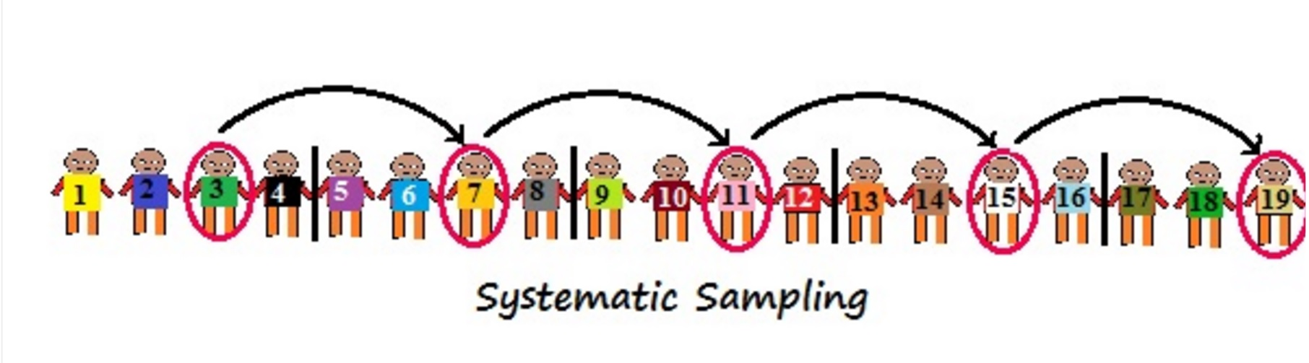
Systematic Samples

Slide 56
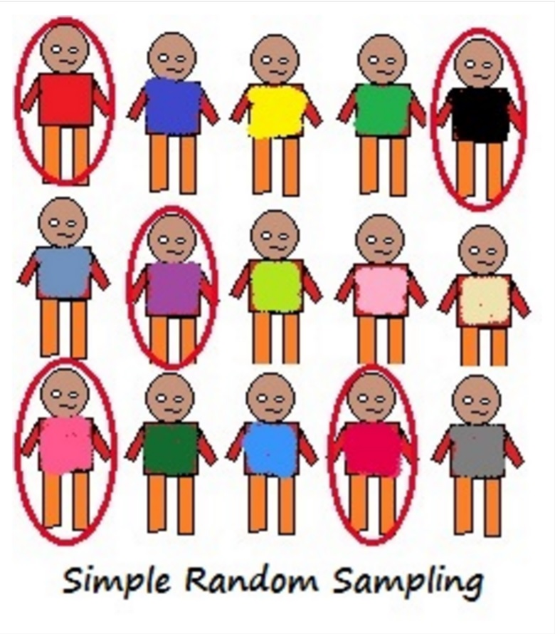
Simple Random Sample
Each case has an ‘equal and non-zero’ chance of inclusion

Slide 57
Exercise 1 Study Designs

Slide 58
A Systematic Sample
Buttons
Cinderella
Robin Hood
Sleeping Beauty
Prince Charming
Snow White
Aladdin
Little Red Riding Hood
Peter Pan
Goldilocks
Sampling Fractions 1/2

Slide 59
A Systematic Sample
Buttons
Cinderella
Robin Hood
Sleeping Beauty
Prince Charming
Snow White
Aladdin
Little Red Riding Hood
Peter Pan
Goldilocks
Sampling Fractions 1/2

Slide 60
A Simple Random Sample http://stattrek.com/statistics/random-number-generator.aspx
Buttons
Cinderella
Robin Hood
Sleeping Beauty
Prince Charming
Snow White
Aladdin
Little Red Riding Hood
Peter Pan
Goldilocks
Sampling Fractions 1/2

Slide 61
END OF EXERCISE

Slide 62
Part 0 Selecting Samples

Slide 63
Simple Random Samples
Each case has an ‘equal and non-zero’ chance of inclusion
A high degree of representativeness…

Slide 64
Simple Random Samples
Each case has an ‘equal and non-zero’ chance of inclusion
A high degree of representativeness…
Random selection greatly reduces selection biases
Inference from the ‘sample’ data can be drawn about the population

Slide 65
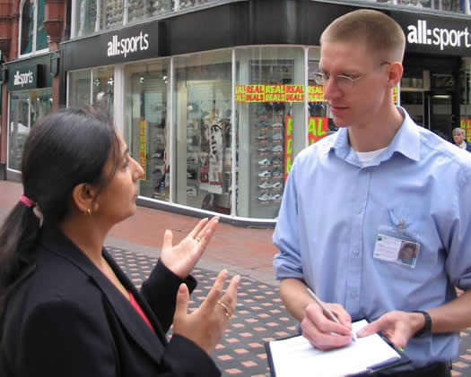
Not a simple random sample
Each case does not have an ‘equal and non-zero’ chance of inclusion

Slide 66
Simple Random Sample
Each case has an ‘equal and non-zero’ chance of inclusion

Slide 67
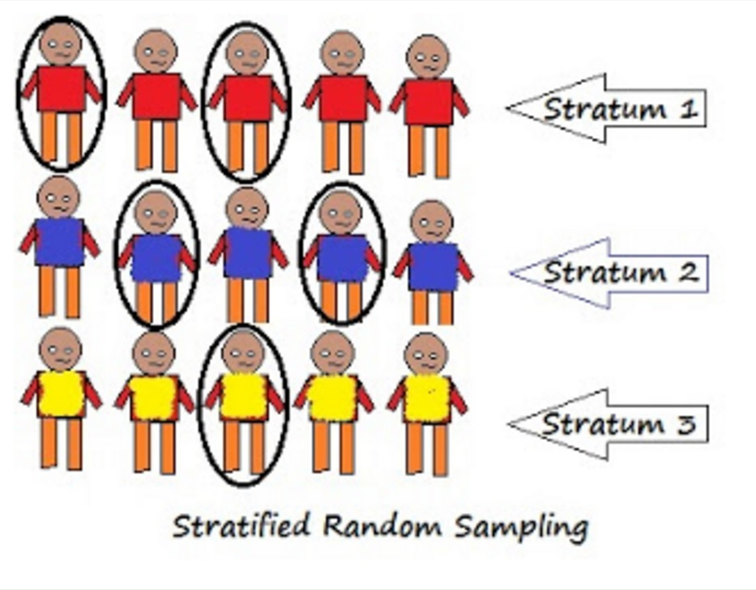
Stratified Samples

Slide 68
Stratified Random Sample
The stratified random sample is usually an improvement on the simple random sample
It better reflects the underlying pattern of the population being studied

Slide 69
Stratified Random Sample
In my PhD I stratified the sampling frame by Gender, Faculty, Age Category and then drew my sample(s)
I wanted to get a highly representative sample that reflected the student population of my university

Slide 70
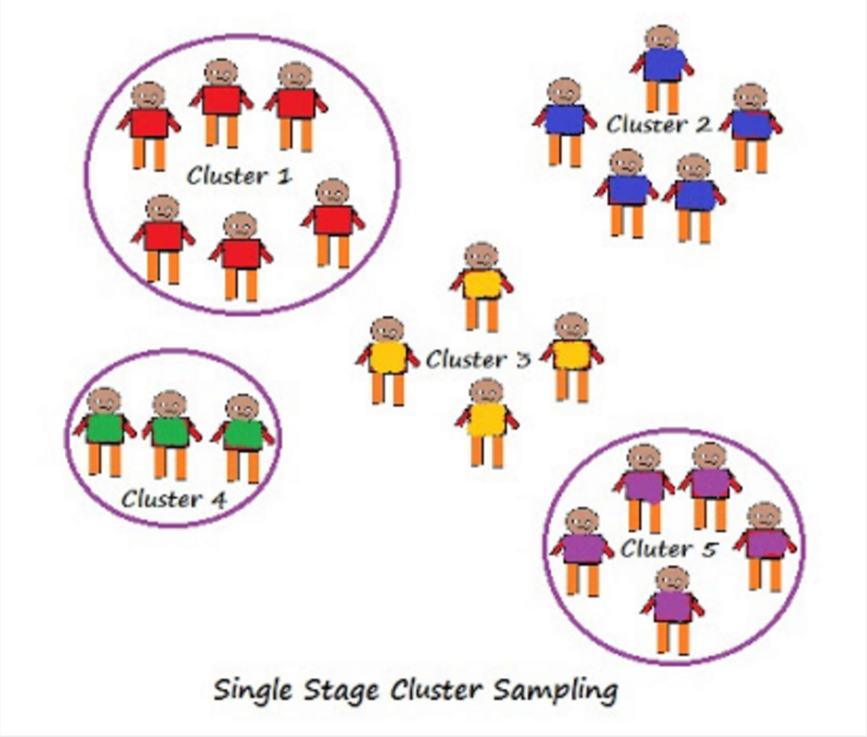
Clustered Samples

Slide 71
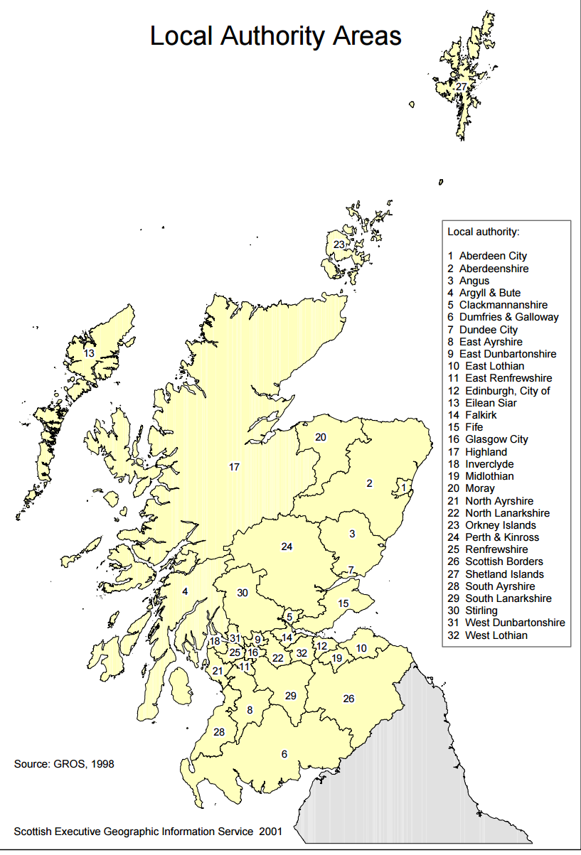
Cluster(ed) Samples
Cases are chosen from ‘some’ clusters
Each case no longer has an
‘equal and non-zero’ chance of inclusion
Practical fieldwork (e.g. interview) and cost benefits

Slide 72
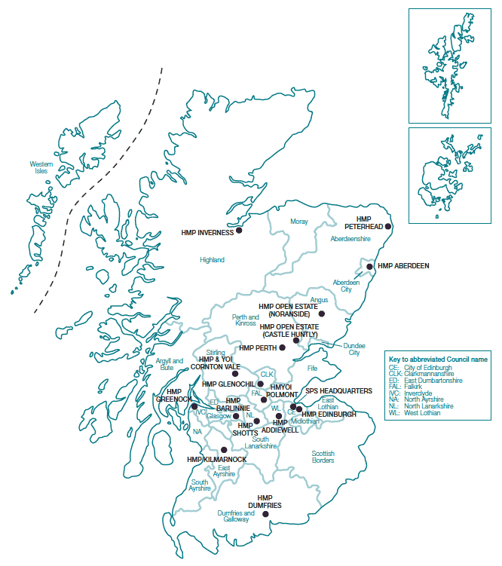
Cluster(ed) Samples
Cases are chosen from ‘some’ clusters
Access negotiations for fewer organisations

Slide 73
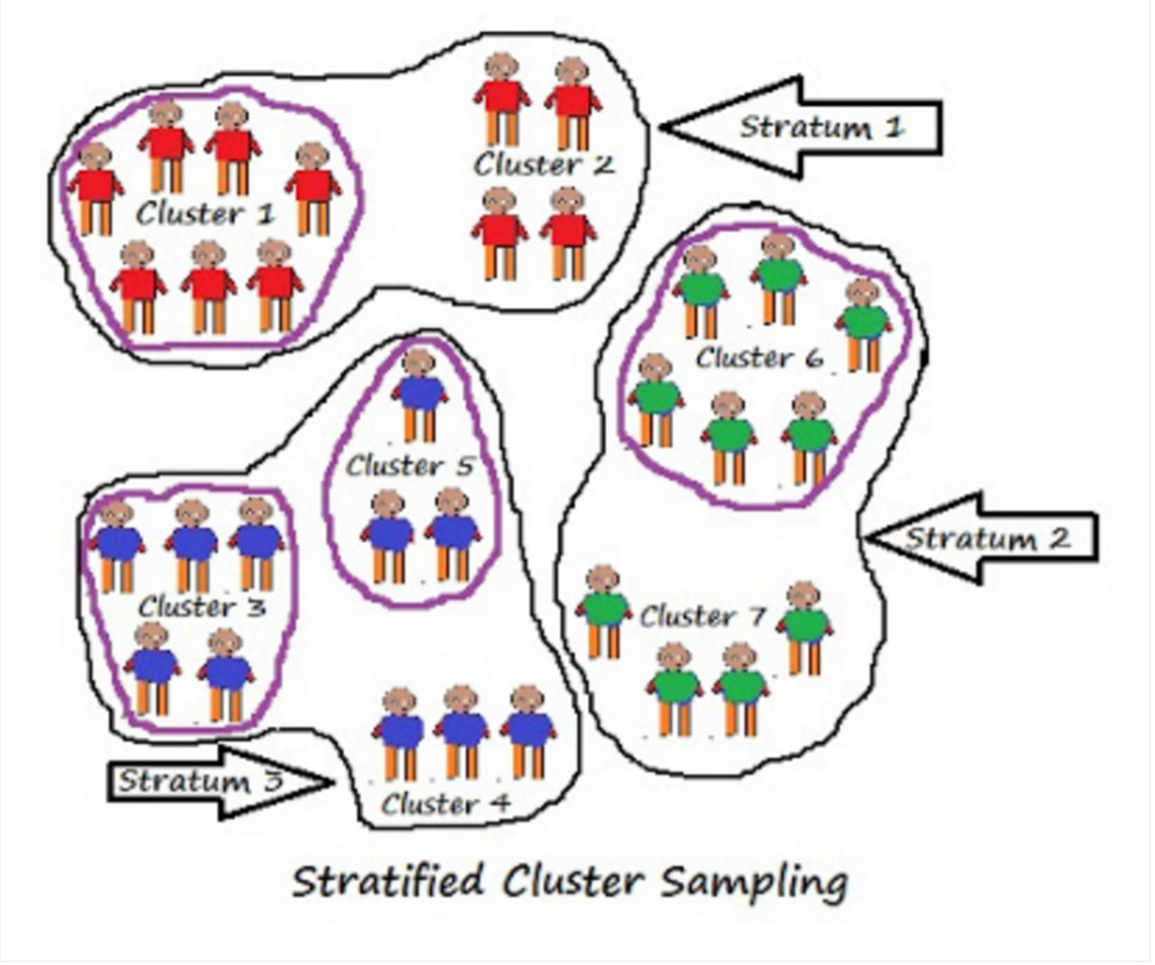
Stratified Cluster Samples

Slide 74
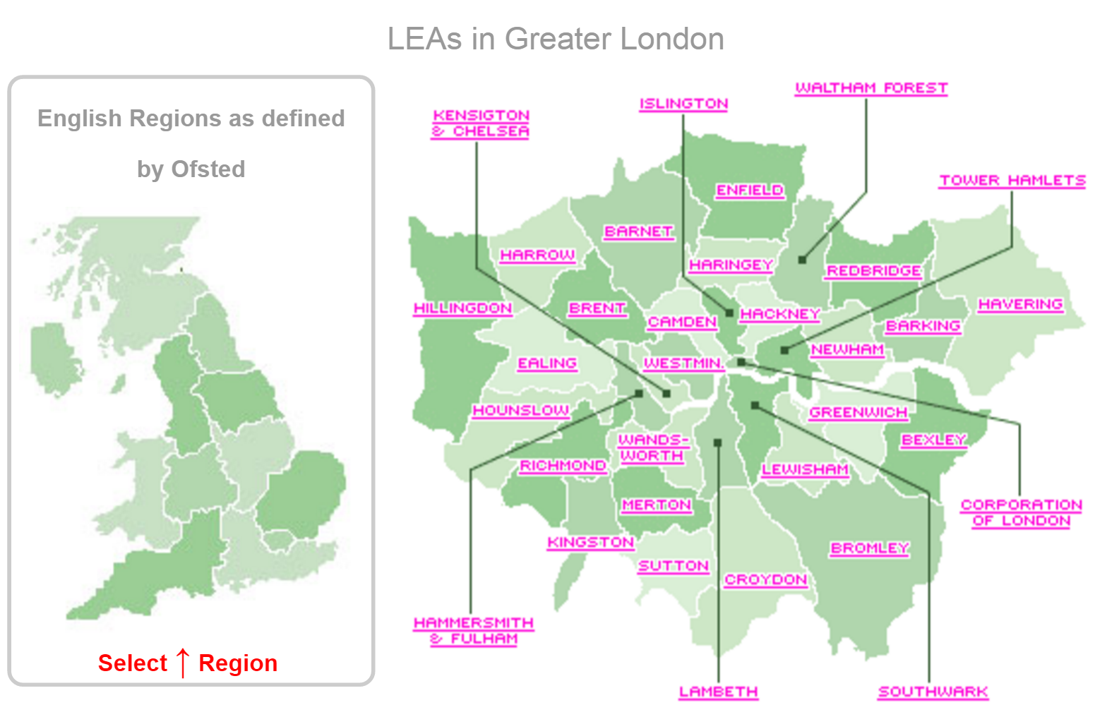
Multistage Cluster
Region
Educational Authorities
Primary Schools
Parents

Slide 75
Part 0 The Design of Some Major Surveys

Slide 76
1958 British birth cohort (National Child Development Study)
All births that took place during March 3–9, 1958
1970 British Birth Cohort (BCS70)
All births that took place during April 5–11, 1970

Slide 77
BHPS Sample Design
A stratified design drawn from the Postcode Address File (PAF)
All residents present at the selected addresses at the first wave of the survey were designated as panel members
These same individuals were re-interviewed each successive year

Slide 78
Following BHPS Members
If sample members split away from the original household to form new households they were still followed
All adult members of their new households were are also interviewed
This is a very important feature of the BHPS design because it led to more wide-ranging data collection

Slide 79
BHPS Samples
The original BHPS survey contained 10,264 respondents
Wave A (1991)
4,833 men and 5,431 women
5,511 households
Wave R (2008) 14,419 respondents living in 8,144 households
By the time of the formal end of the BHPS, 43,272 adults had been interviewed at some time during the eighteen waves of the survey

Slide 80
Extension Samples The British Household Panel Survey
Welsh extension from 1999 (Wave 9) (n=1500 households)
Scottish extension from 1999 (Wave 9) (n=1500 households)
Northern Ireland extension from 2001 (Wave 11) (n=1900 households)
Why was the Northern Ireland sample not clustered?
Former European Community Household Panel survey low-income sub-sample from1997 to 2001 (Waves 7 to 11) (n=1,000 households)

Slide 81
Understanding Society – The UK Household Longitudinal Study (UKHLS)
UKHLS shares common design and data collection characteristics with the BHPS
Began in January 2009
40,000 UK households
Largest household panel survey in the world
Hobcraft and Sacker (2011) provide an overview of the origins and development of the UKHLS
The UKHLS is available from the UK Data Archive (Study Number 6614)

Slide 82
Understanding Society – The UK Household Longitudinal Study (UKHLS)
General population survey
Ethnic minorities boost sample
BHPS
Innovation Panel

Slide 83
Understanding Society – The UK Household Longitudinal Study (UKHLS)
Wave A (a_sex)
50,994 adult interviews
23,202 males (46%)
27,792 females (46%)

Slide 84
Understanding Society – The UK Household Longitudinal Study (UKHLS)
Country of Residence Wave A (a_country)
England 42,972 (84%)
Wales 2,378 (5%)
Scotland 3,556 (7%)
Northern Ireland 2,088 (4%)

Slide 85
Understanding Society – The UK Household Longitudinal Study (UKHLS)
General population survey
Ethnic minorities boost sample
BHPS
Innovation Panel

Slide 86
The general population survey is a stratified clustered equal probability sample of residential addresses drawn to a uniform design throughout all of the UK (including the north of Scotland)
The Northern Irish sample is not clustered however
Within Great Britain the Primary Sampling Units (PSUs) are postal sectors
They are stratified by the nine official regions of England, plus Scotland and Wales, by population density and by ethnic minority density
This resulted in the systematic selection of 2,640 postal sectors with probability proportional to size (number of addresses)

Slide 87
Within each sampled sector, 18 addresses were selected systematically, resulting in an equal probability sample of 47,520 addresses in Great Britain
In Northern Ireland 2,400 addresses were selected systematically from the Land and Property Services Agency list of domestic properties

Slide 88
Response Rates
General population survey 57.2% (60% target)
Ethnic minority boost 56.9% (55% target)
These rates are common for omnibus surveys in the UK (Buck and McFall, 2012)
Burton et al. (2011) provide in-depth information on UKHLS response rates

Slide 89
Types of UKHLS Respondents
Original Sample Members (OSM)
Present in households at the start of the study
They are always followed
Temporary Sample Members (TSM)
Join a households with an OSM
Only surveyed if living with an OSM

Slide 90
UKHLS Following Rules (Example)
When an adult female OSM moves in with her male partner she will also be interviewed and will become a TSM
A TSM is not followed when they no longer live in a household with an OSM
If a male TSM fathers a child with an OSM they become a Permanent Sample Member (PSM) and remain potentially eligible for interview for the life of survey

Slide 91
UKHLS Following Rules
The rules that guide following UKHLS respondents are designed to mimic the demographic processes by which the population is reproduced
This includes births, deaths, partnership formations and dissolutions and emigration
The study’s ‘following rules’ provide an organic selection method which over time represent the evolving pattern of families and households in the UK

Slide 92
Part 0 Working with Complex Surveys Using Software

Slide 93

You can’t analyse complex surveys without

Slide 94
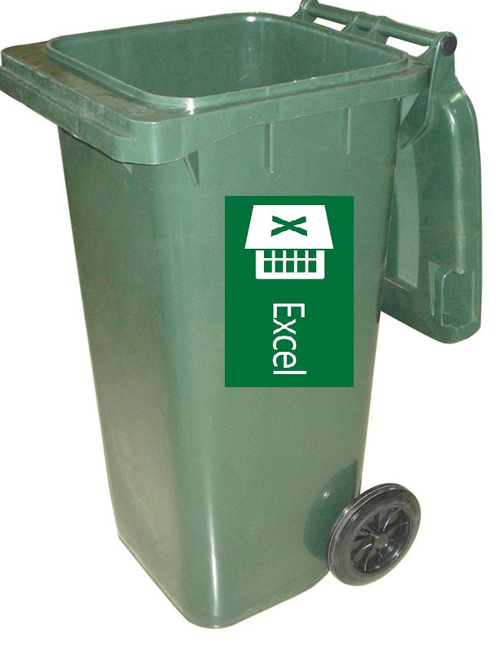
Don’t try to use Excel

Slide 95
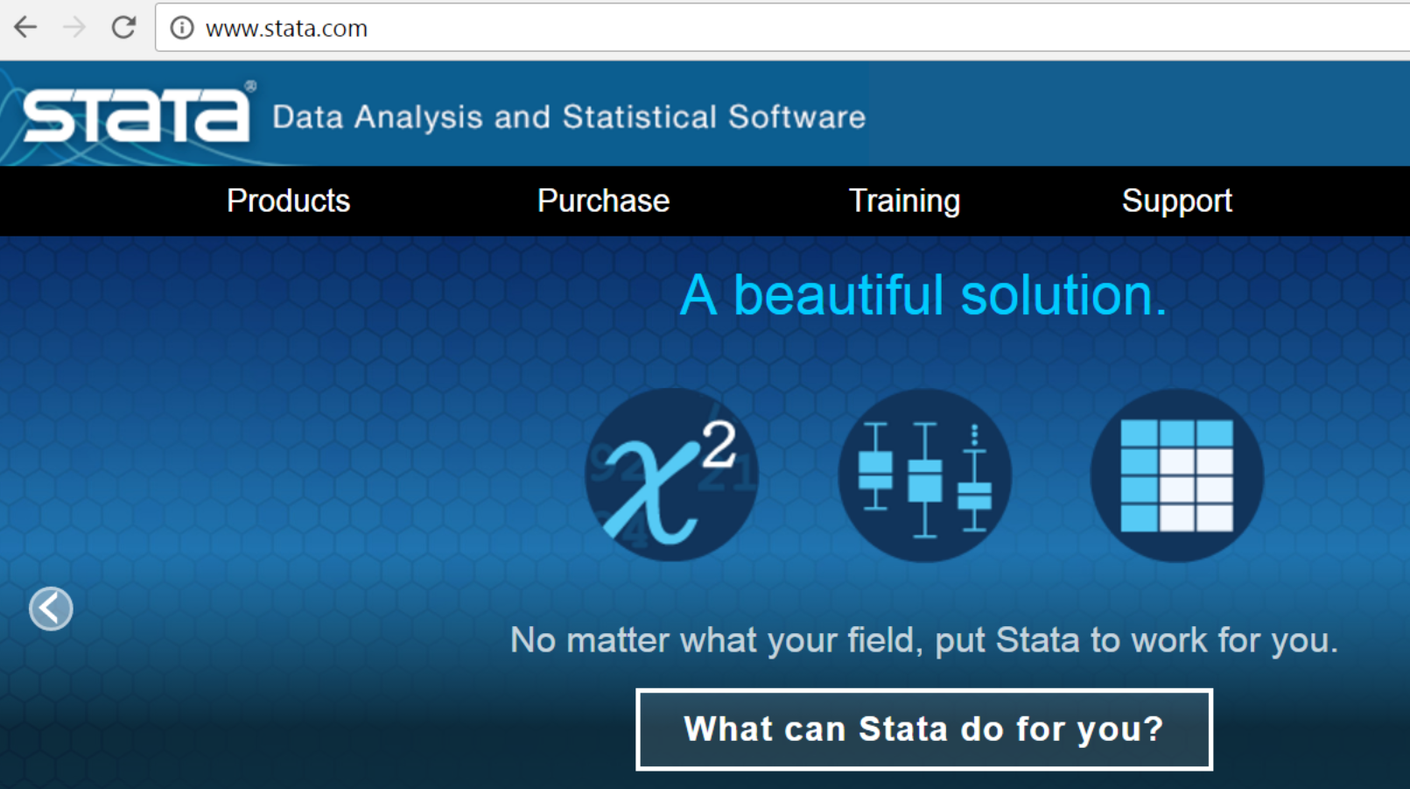

Slide 96
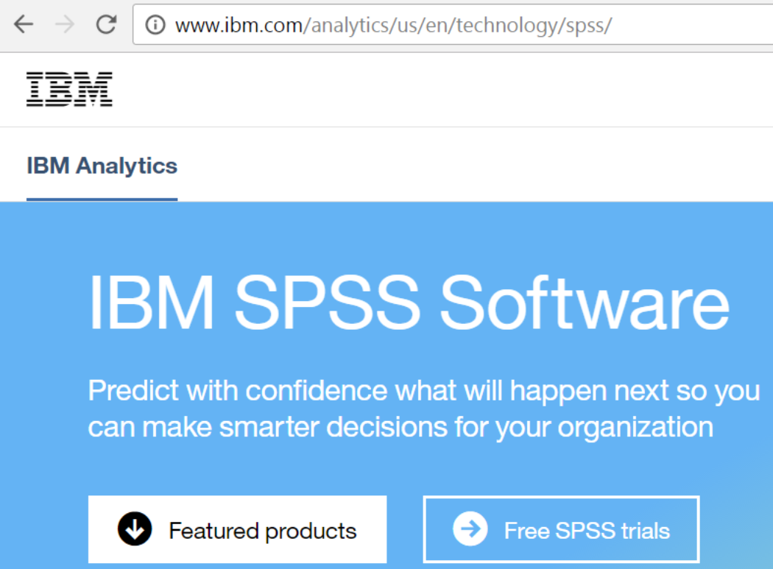
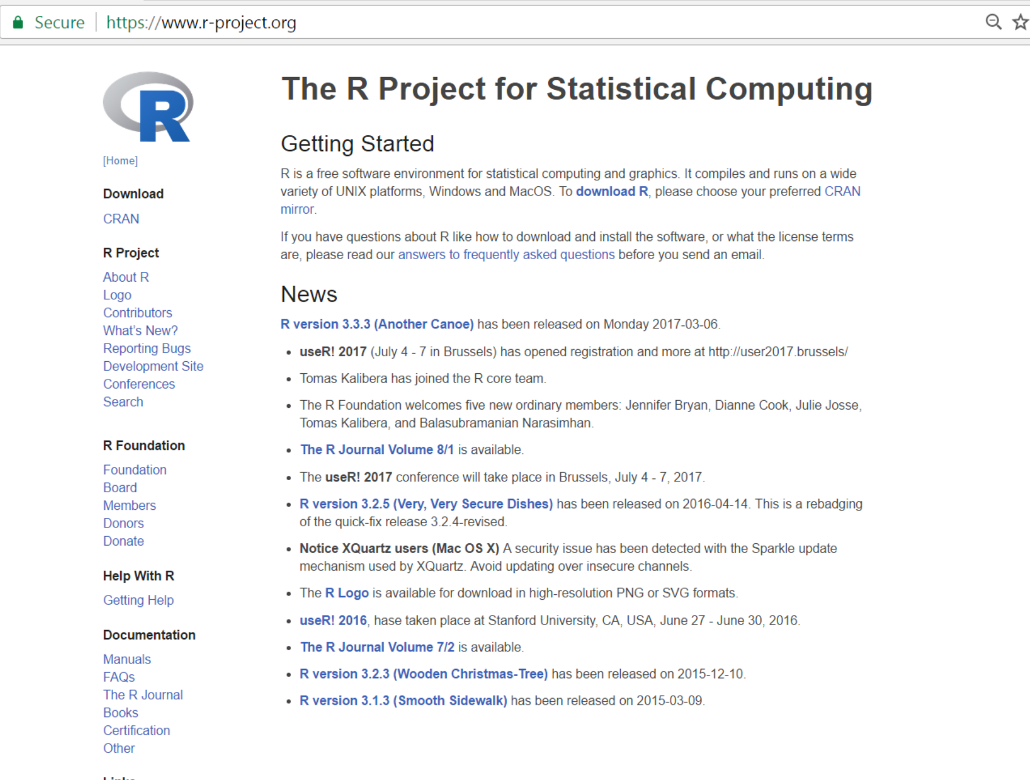

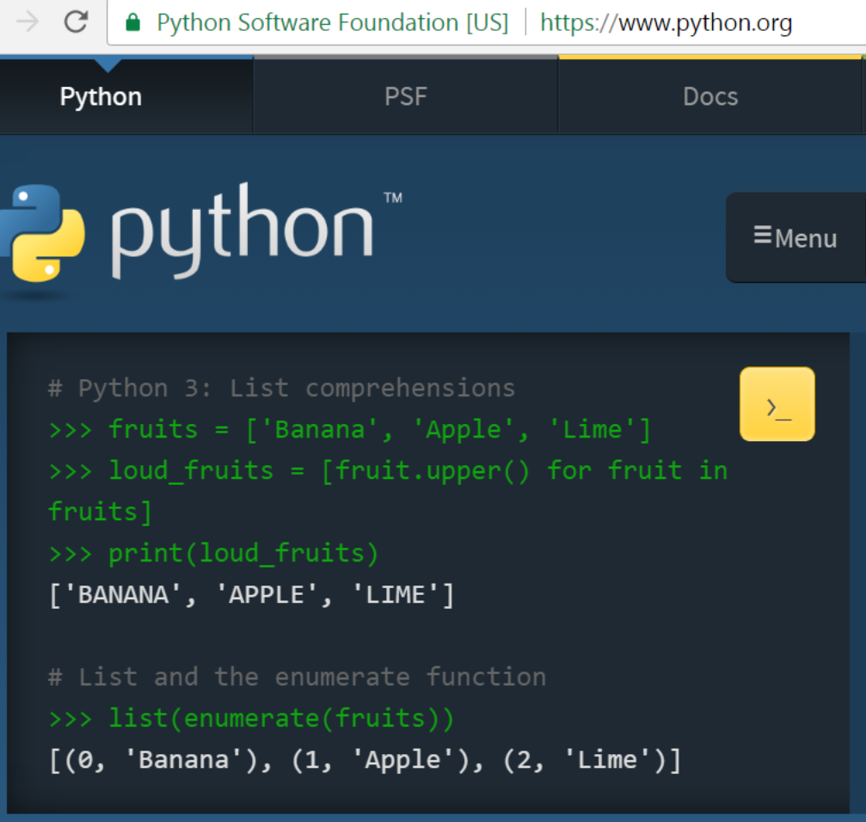

Slide 97
Survey data analysts are free to use whatever software they prefer…

Slide 98
Why Stata
A wide (and growing) user community
Excellent documentation and help files
A helpful forum (www.statalist.org)
Many good and accessible training resources
Stata http://www.stata.com/training/
UCLA http://stats.idre.ucla.edu/stata/
Timberlake http://www.timberlake.co.uk/training
Princeton http://data.princeton.edu/stata/
My old site www.longitudinal.stir.ac.uk

Slide 99
Stata Offers a Unified Environment
Data Enabling (i.e. preparing complex survey data for analyses)
Exploratory Data Analysis
Comprehensive data analysis
Models in the regression family (glm)
Selection models
Multilevel models
Event history models
Longitudinal models (e.g. panel models)

Slide 100
Stata Offers a Unified Environment
APPROPRIATE analysis of surveys with complex designs and selection strategies!
The production of presentation and publication ready outputs
(i.e. output suitable for reports and journal articles)

Slide 101
A leading US social scientist and survey data analyst Donald J. Treiman makes the following comments on Stata
‘for many years, SPSS was the package of choice among sociologists probably because it was written by and for sociologists…Although it is still widely used by social scientists in Europe and Asia it has lost its market share in leading U.S. research universities… [Stata] has gotten better and better over time, so that by now it can happily be used as a general-purpose package. Stata is powerful and fast which makes it viable to carry out analysis on a PC… Overall, Stata is a very good choice for our kind of work’ (Treiman, 2009 p.66).

Slide 102
The UK Data Service provides most large-scale social surveys in SPSS and Stata format
SPSS is far more restricted in the range of statistical models that it can estimate
SPSS currently has few options for estimating models that are suited to longitudinal data
Stata is able to offer more comprehensive facilities to analyse survey datasets with complex designs and selection strategies
This is a clear benefit for social scientists working with contemporary datasets such as the UK Household Longitudinal Study (Understanding Society) and the UK Millennium Cohort Study

Slide 103
Part 0 Working with Complex Surveys The Workflow

Slide 104
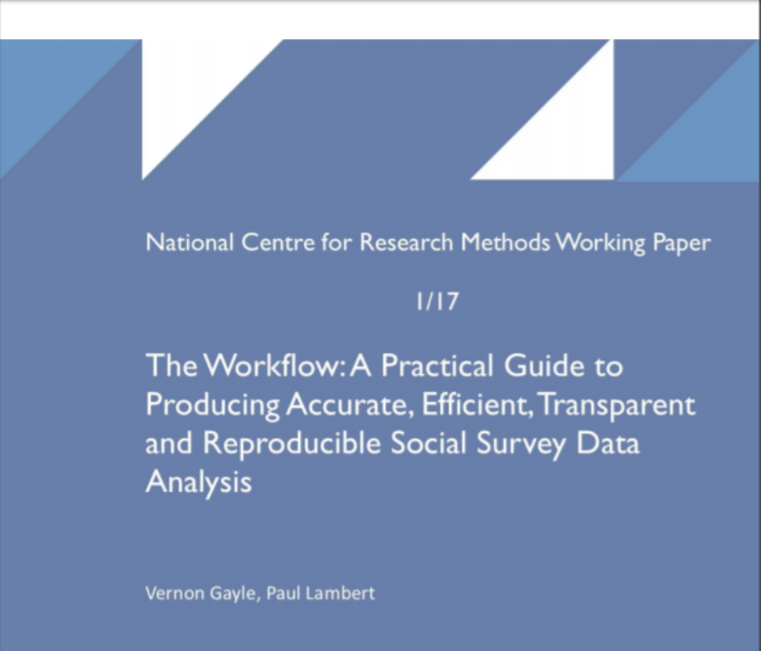
http://eprints.ncrm.ac.uk/4000/

Slide 105
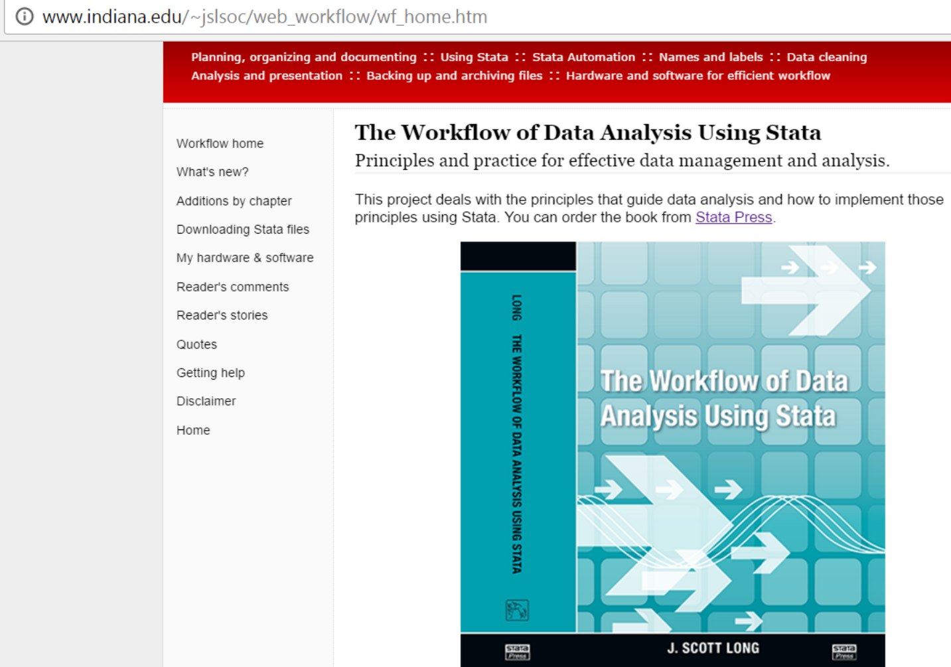
J. Scott Long has posted a really good pdf version of a talk on the workflow http://www.ihrp.uic.edu/files/Workflow%20Slides%20JSLong%20110410.pdf

Slide 106
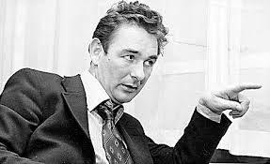
The best habit that you can get into
is to get into good habits!

Slide 107

Estimating the time taken to enable complex survey data for analysis

Slide 108
Part 0 Working with Complex Surveys Enabling Data

Slide 110
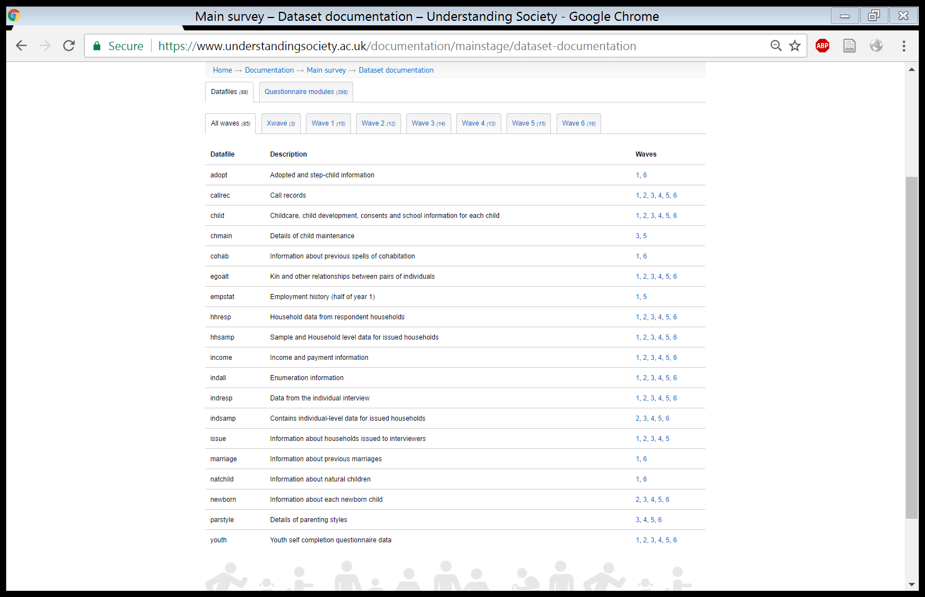
Multiple Files

Slide 111
Types of File (main files)
Data from the individual interview
Individual response files a_indresp b_indresp
Household data from respondent households
Household response files a_hhresp b_hhresp

Slide 112
Types of File (other files)
Youth self completion questionnaire data
Ages 10-15 a_youth b_youth c_youth
Income and payment information a_income

Slide 113
Useful Files
Stable characteristics of individuals xwavedat
Individual and household identifiers across all waves xwaveid

Slide 114
Linking Up People and Households

Slide 115
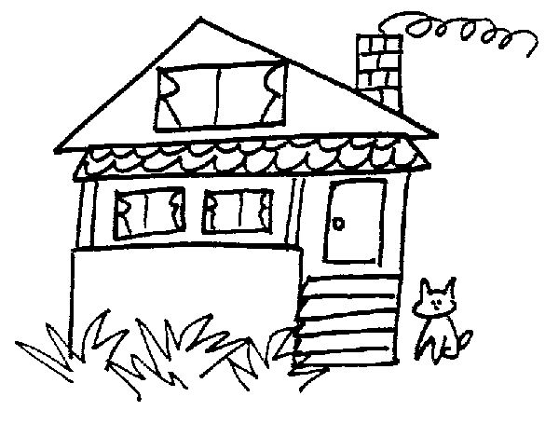

a_hidp 68001363
Household
(resident)
pidp 68001366

Slide 116
a_hidp 68001363
b_hidp 68001365
c_hidp 68001367
d_hidp 68001369
Household
(resident)
Household
(resident)
Household
(resident)
Household
(resident)
pidp 68001366
pidp 68001366
pidp 68001366
pidp 68001366

Slide 117

Household
(resident)
Household
(resident)
pidp 68001360
pidp 68001366

Slide 118
a_hidp 68001363
a_hidp 68001363
Household
(resident)
Household
(resident)
pidp 68001360
pidp 68001366
a_sppid 68001360
a_sppid 68001366

Slide 119

a_hidp 68001363
b_hidp 68001365
c_hidp 68001367
Household
(resident)
Household
(resident)
pidp 68001366
pidp 68001366
pidp 68001366
a_sppid 68001360
b_sppid -8
c_sppid 6800159

Slide 120
Household
(resident)
a_hidp Household identifier
a_pno Person number in household grid
pidp Cross-wave person identifier
fpid Cross-wave person identifier of natural father
mpid Cross-wave person identifier of natural mother

Slide 121
A Genuine Example
a_hidp 68251603 Household identifier
a_pno 4 Person number in household grid
pidp 68251619 Cross-wave person identifier
fpid 68251607 Cross-wave person identifier of natural father
mpid 68251611 Cross-wave person identifier of natural mother

Slide 122
Variables and Measures

Slide 123
Time varying variables…

Slide 124
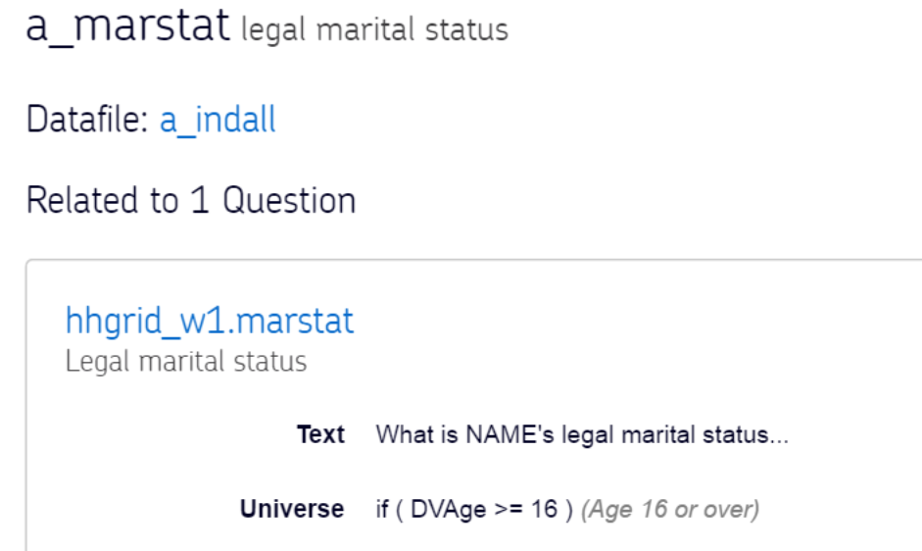
a_marstat legal marital status

Slide 125
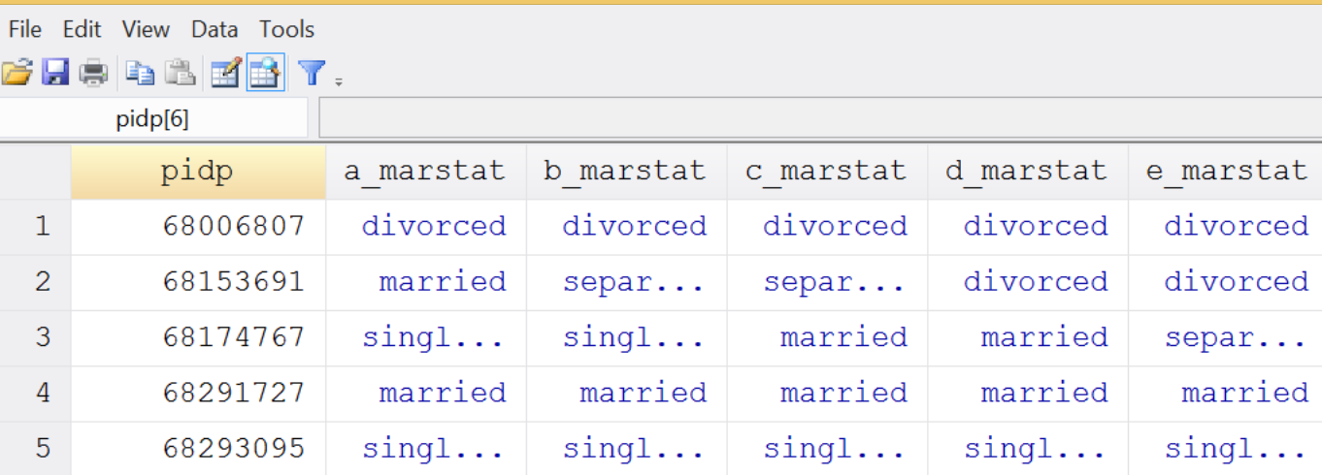
a_marstat legal marital status

Slide 126
Time constant variables…

Slide 127
tab a_ukborn, missing
born in uk | Freq. Percent Cum.
----------------------+-----------------------------------
missing | 6 0.01 0.01
refused | 2 0.00 0.02
don't know | 8 0.02 0.03
yes, england | 33,480 65.65 65.69
yes, scotland | 3,567 6.99 72.68
yes, wales | 2,154 4.22 76.91
yes, northern ireland | 2,033 3.99 80.89
not born in the uk | 9,744 19.11 100.00
----------------------+-----------------------------------
Total | 50,994 100.00

Slide 128
tab a_ukborn, missing
born in uk | Freq. Percent Cum.
----------------------+-----------------------------------
missing | 6 0.01 0.01
refused | 2 0.00 0.02
don't know | 8 0.02 0.03
yes, england | 33,480 65.65 65.69
yes, scotland | 3,567 6.99 72.68
yes, wales | 2,154 4.22 76.91
yes, northern ireland | 2,033 3.99 80.89
not born in the uk | 9,744 19.11 100.00
----------------------+-----------------------------------
Total | 50,994 100.00
tab b_ukborn, missing
born in uk | Freq. Percent Cum.
----------------------+-----------------------------------
missing | 1 0.00 0.00
inapplicable | 46,811 69.66 69.66
don't know | 8 0.01 69.67
yes, england | 4,834 7.19 76.86
yes, scotland | 599 0.89 77.75
yes, wales | 402 0.60 78.35
yes, northern ireland | 355 0.53 78.88
not born in the uk | 1,587 2.36 81.24
. | 12,606 18.76 100.00
----------------------+-----------------------------------
Total | 67,203 100.00

Slide 129
. tab b_ukborn b_hhorig
| sample origin
born in uk | ukhls gb ukhls ni bhps gb 1 bhps sco bhps wal bhps ni 2 ukhls emb | Total
----------------------+-----------------------------------------------------------------------------+----------
missing | 0 0 0 0 0 0 1 | 1
inapplicable | 30,018 1,655 5,961 1,436 1,601 1,908 4,232 | 46,811
don't know | 5 0 1 0 1 0 1 | 8
yes, england | 3,765 10 518 9 33 6 493 | 4,834
yes, scotland | 407 2 52 125 4 3 6 | 599
yes, wales | 222 0 29 0 150 0 1 | 402
yes, northern ireland | 24 174 4 2 1 148 2 | 355
not born in the uk | 664 17 33 4 5 2 862 | 1,587
----------------------+-----------------------------------------------------------------------------+----------
Total | 35,105 1,858 6,598 1,576 1,795 2,067 5,598 | 54,597

Slide 130
Choosing between variables (and measures)…

Slide 131
Understanding Society Income Measures
Wages
Self employment
Second job earning
Interest and dividends
Pensions
Benefits
Educational grants
Maintenance (alimony)
Payments from family members
Rent and lodgers
Other sources

Slide 132
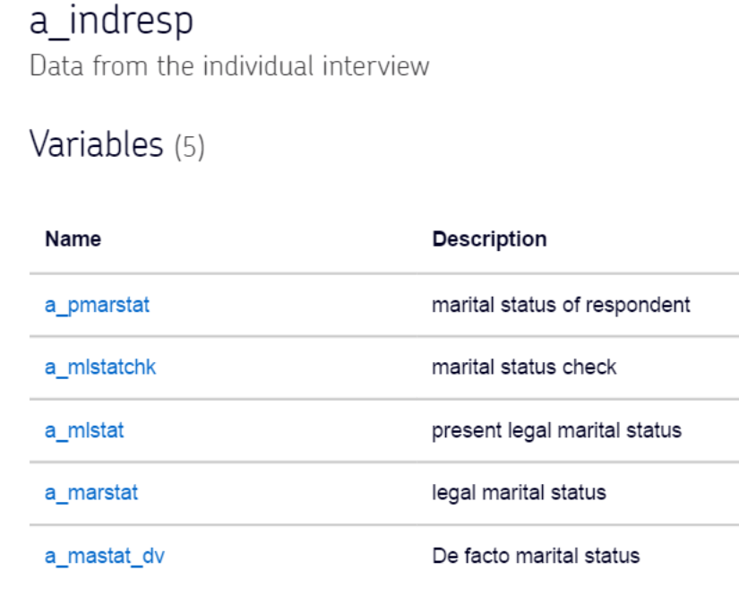
Marital Status Measures

Slide 133
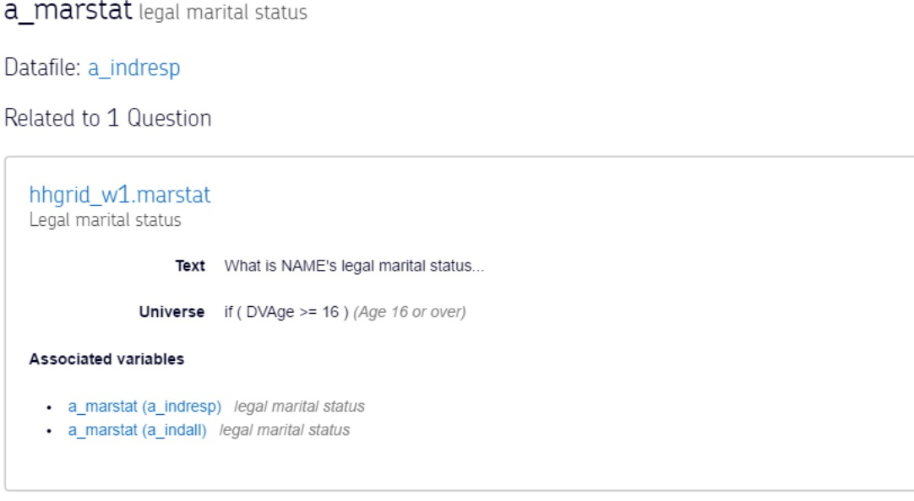

Slide 134
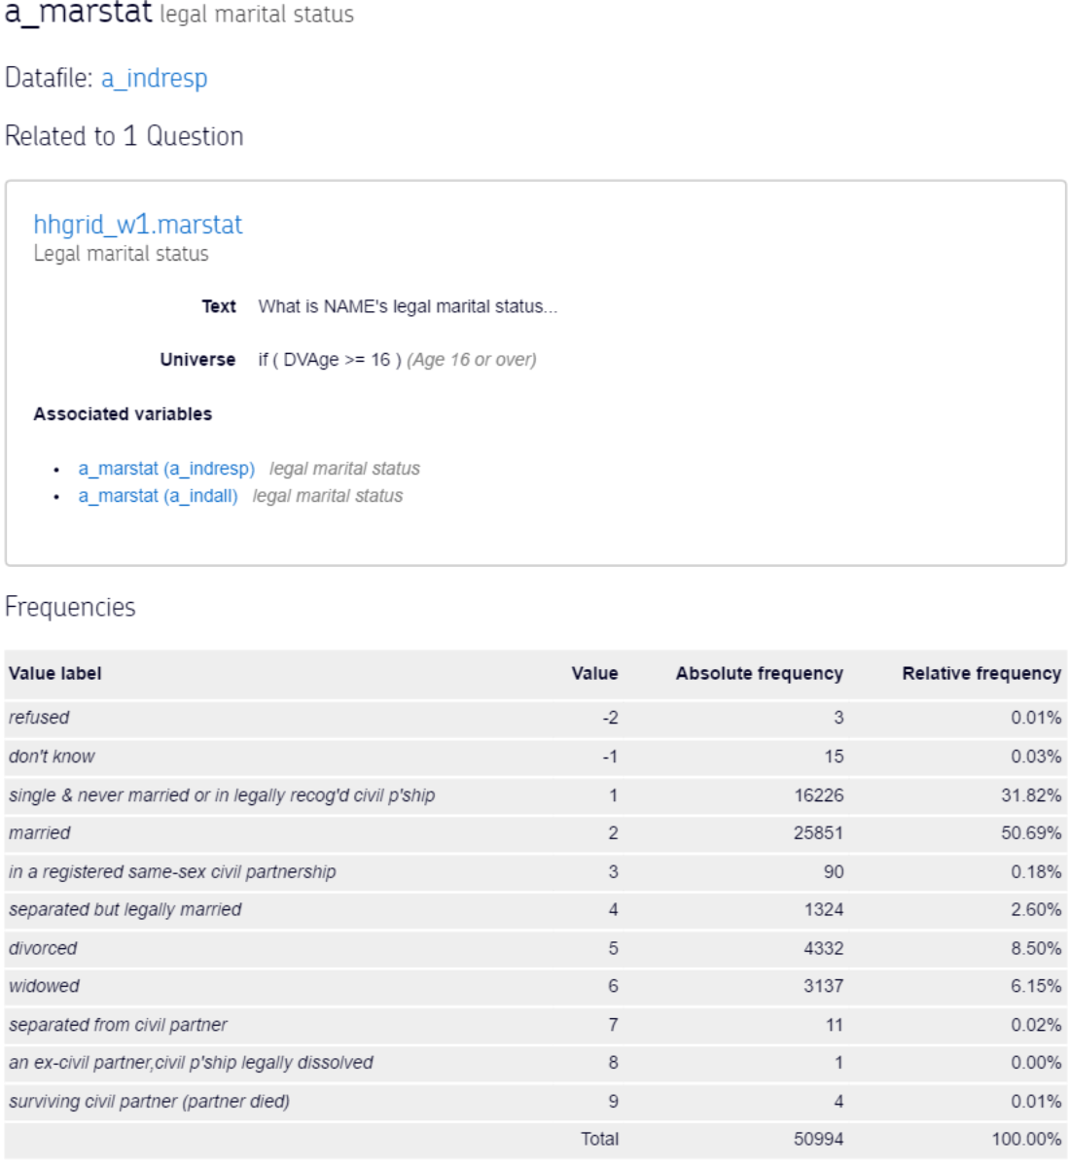

Slide 135
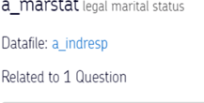
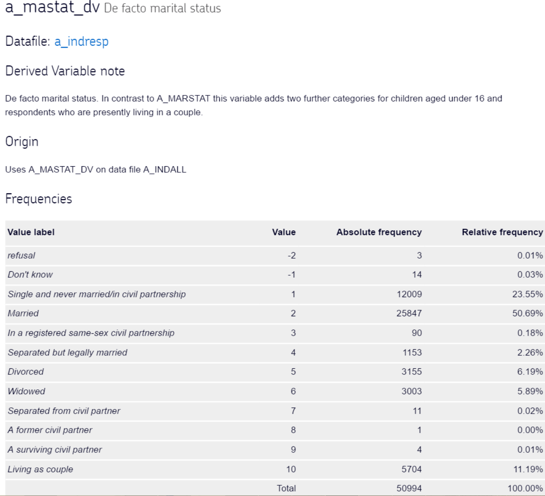
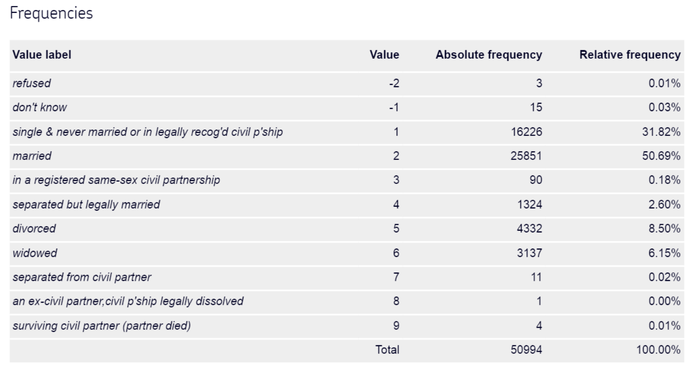

Slide 136
Choosing between variables (and measures)…
Think hard about which measure(s) are best suited to your research question
Is there a good theoretical justification for your choice of measure?
Is the measure commonly used?
Is using the measure practicable?
How does the measure compare with other measures?
UNDERTAKE (and publish) a SENSITIVITY ANALYSIS!

Slide 137
Part 0 Survey Weights

Slide 138
Survey Weight sɜːveɪ weɪt/ noun confusing Adjusts a sample to better represent a population of interest

Slide 139
Adjusting a sample to better represent a population of interest
A survey with a target population with 50% men and 50%
There are 400 respondents
75% are male (n=300)
25% are female (n=100)

Slide 140
Adjusting a sample to better represent a population of interest
A survey with target population with 50% men and 50%
There are 400 respondents
75% are male (n=300)
25% are female (n=100)
Could we re-scale the sample to better represent the population?

Slide 141
A simple example of weighting data Adjusting a sample to better represent a (target) population of interest

Slide 142
Adjusting a sample to better represent a population of interest
 | Males | Females
Target Population | 50% | 50%
Target number of interviews | 200 | 200

Slide 143
Adjusting a sample to better represent a population of interest
 | Males | Females
Target Population | 50% | 50%
Target number of interviews | 200 | 200
Achieved number of survey interviews | 300 | 100

Slide 144
Adjusting a sample to better represent a population of interest
 | Males | Females
Target Population | 50% | 50%
Target number of interviews | 200 | 200
Achieved number of survey interviews | 300 | 100
Ratio of achieved to target | 300/200 = 1.5 | 100/200 = 0.5

Slide 145
Adjusting a sample to better represent a population of interest
 | Males | Females
Target Population | 50% | 50%
Target number of interviews | 200 | 200
Achieved number of survey interviews | 300 | 100
Ratio of achieved to target interviews | 300/200 = 1.5 | 100/200 = 0.5
Weighting factor | 1/1.5 = 0.67 | 1/0.5 = 2

Slide 146
A National Survey of Pupils in England and Wales in 1990
 | Less than 5 GCSEs | 5+ GCSEs
Population percentage | 65 | 35
No observed in survey | 7,800 | 6,469
Unweighted percentage | 55 | 45

Slide 147
A National Survey of Pupils in England and Wales in 1990
 | Less than 5 GCSEs | 5+ GCSEs
Population percentage | 65 | 35
No observed in survey | 7,800 | 6,469
Unweighted percentage | 55 | 45
Ratio of achieved to target | 55/65 | 45/35
Survey weight | 1 / (55/65)= 1.18 | 1 / (45/35) = .78
Weighted percentage | 55 x 1.18 = 65 | 45 x .78 = 35
Youth Cohort Study of England and Wales Cohort 5; GCSEs at grades A-C

Slide 148
The statistical literature on survey design, sampling and weighting is dense and the terminology and concepts that are used are often confusing for social science researchers
The web based resource Practical Exemplars and Survey Analysis (PEAS) http://www.restore.ac.uk/PEAS/about.php provides a useful and accessible introduction (although it is no longer being up-dated)

Slide 149
Concluding Remarks on Weights…
Gelman (2007) makes the bold assertion that ‘survey weighting is a mess’ , because it is not always clear how to use weights in estimating anything other than simple descriptive statistics and because software packages do not always have procedures available for complex adjustments to be made

Slide 150

Concluding Remarks on Weights…
Joshua Angrist and Jörn-Steffen Pischke assert that
‘few things are as confusing to applied researchers as the role of sample weights. Even now, 20 years post-Ph.D.’
(Angrist and Pischke, 2008 p.66)

Slide 151
Part 0 Analysing Complex Surveys using Stata

Slide 152
Complex Survey Analysis in Stata
svy
The svy prefix is designed for use with complex survey data
Typical survey design characteristics include sampling weights, clustered sampling, and stratification
Many routine analyses can be undertaken in Stata once the characteristics of the data have been set, and the results will be suitably adjusted to represent the complexity of the survey’s design

Slide 153
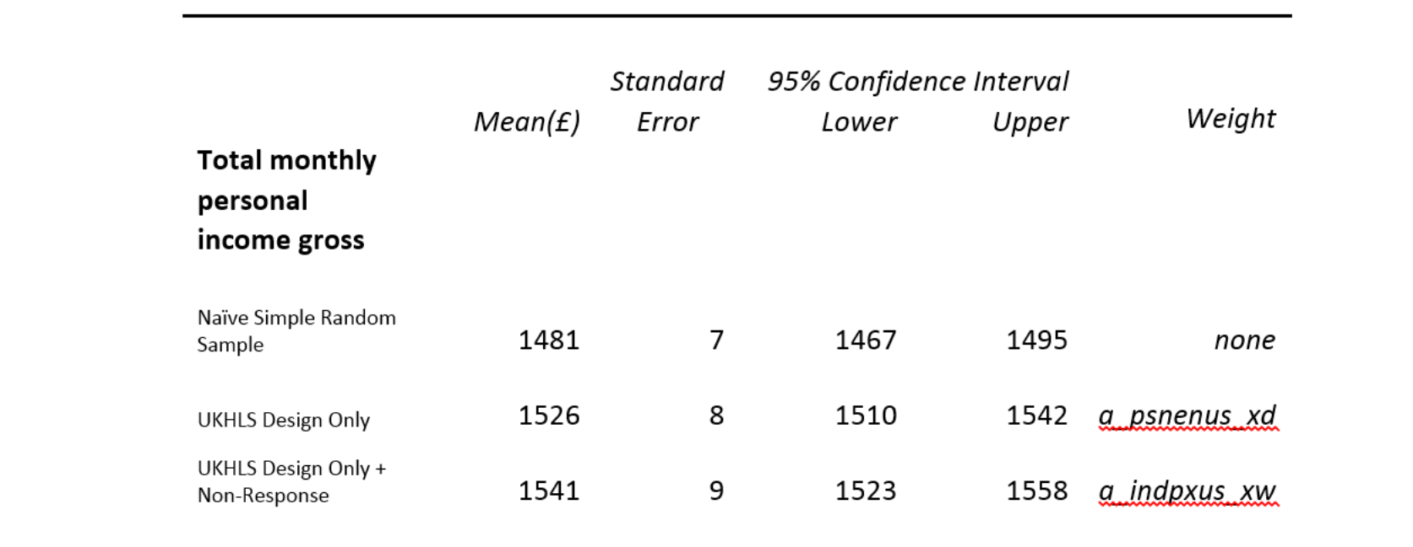
UKHLS Example

Slide 154
UKHLS Example

Slide 155
UKHLS Example

Slide 156
A Warning Against A Naïve Approach to Inference
‘NEVER conduct unweighted analysis if you aim to generalise your results to the UK population’ (Understanding Society – UK Household Longitudinal Study: Wave 1, 2009-2010 User Manual – 24 October 2011)

Slide 157
Part 0 Remarks and Conclusions

Slide 158


Slide 159
Complex Social Surveys
You might never conduct a complex survey…
You might never analyse a complex survey dataset…
But you may need to read results from the analysis of complex social survey and therefore wish to understand more

Slide 160
Things you might consider when reading analyses using complex social surveys….
Was the most appropriate survey used?
Did the researchers think about the survey design and selection strategy?
Were an optimal set of cases used?

Slide 161
Things you might consider when reading analyses using complex social surveys….
Could extra information have been incorporated (e.g. from other household members)?
Did the researchers think about the effects of missing data (i.e. units and items)?
Were the most suitable Y and X vars used?
Is there sufficient information about the analytical process?

Slide 162
Things you might consider when commissioning an analysis….
Is the data analyst suitably trained?
How well do they know the dataset?
How many dates have they been on!
Is there sufficient time to get to know the dataset?
Is there sufficient (funded?) time for data enabling?

Slide 163
Things you might consider when commissioning an analysis….
Can you and your organisation publically defend the work?
Will the data analysis process be transparent?
Will the work be archived and rendered reproducible?

Slide 164
Things you might think about before analysing complex social surveys…
Learn how to use an suitable software package (e.g. Stata)
Come to graduate school at either Edinburgh or Warwick
Attend a course run by AQMeN (http://aqmen.ac.uk/)
Consult the resources page on our website
http://www2.warwick.ac.uk/fac/soc/sociology/staff/connelly/cognitiveinequalities

Slide 165


Slide 166
The Future
The analysis of surveys with complex designs is an emerging area
There will undoubtedly be new theoretical insights which, alongside advances in software functionality and improvements in computational power, will influence data analysis practices

Slide 167
Last Words
Angrist and Pischke (2008) playfully remarked that if applied research was easy then theorists would do it
They also reassure readers that applied research is not as hard as the dense pages of Econometrica might lead us to believe
Most of all don’t panic

Slide 168
Resources on Stata
Stata home page http://www.stata.com/
Stata Bookstore http://www.stata.com/bookstore/books-on-stata/
Stata List http://www.statalist.org/
Stata on Twitter http://twitter.com/#!/stata
Stata Journal http://www.stata-journal.com/
UCLA Academic Technology Services http://www.ats.ucla.edu/stat/stata/
Princeton Stata resources http://data.princeton.edu/stata/
The website of the ESRC 'Longitudinal Data Analysis for Social Science Researchers' project much of my earlier Stata training resources are available on this site www.longitudinal.stir.ac.uk

Slide 169
Introductions to Stata
KOHLER, H. P. & KREUTER, F. 2012. Data Analysis using Stata, College Station, Tx, Stata Press.
(An excellent introduction to Stata)
MEHMETOGLU, M. & JAKOBSEN, T. G. 2016. Applied Statistics Using Stata: A Guide for the Social Sciences, SAGE.
(A very clear new text on using Stata)
PEVALIN, D. & ROBSON, K. 2009. The Stata survival manual, McGraw-Hill Education.
(Students often like this book as an introduction)

Slide 170
Other Useful Texts
LONG, J. S. 2009. The Workflow of Data Analysis Using Stata, College Station, Stata Press.
(The authoritative text on the workflow and organizing data analysis)
LONG, J. S. & FREESE, J. 2014. Regression models for categorical dependent variables using Stata, College Station, Stata press.
(An excellent book on statistical modelling)
LONGHI, S. & NANDI, A. 2014. A Practical Guide to Using Panel Data, Sage.
(A great book on analysing panel data)
RABE-HESKETH, S. & EVERITT, B. 2003. Handbook of statistical analyses using stata, CRC Press.
(This is a comprehensive guide to statistical modelling).
SINGER, J. D. & WILLETT, J. B. 2003. Applied longitudinal data analysis: Modeling change and event occurrence, Oxford university press. (A very good book on longitudinal data analysis)
TREIMAN, D. J. 2009. Quantitative Data Analysis: Doing Social Research to Test Ideas, San Francisco, John Wiley & Sons. (A excellent book with a lot of original material).

Slide 171
More Advanced Texts
CHAMBERS, R. L. & SKINNER, C. J. 2003. Analysis of survey data, John Wiley & Sons.
SKRONDAL, A. & RABE-HESKETH, S. 2004. Generalized latent variable modeling: Multilevel, longitudinal, and structural equation models, Crc Press.
RABE-HESKETH, S. & SKRONDAL, A. 2012. Multilevel and Longitudinal Modeling Using Stata (Volume 1: Continuous Response), Stata Press.
RABE-HESKETH, S. & SKRONDAL, A. 2012. Multilevel and Longitudinal Modeling Using Stata (Volume 2: Categorical Responses, Counts, and Survival), Stata Press.

Slide 172
A Practical Introduction to Analysing Complex Social Survey Data
Vernon Gayle University of Edinburgh vernon.gayle@ed.ac.uk @profbigvern | Roxanne Connelly University of Warwick r.connelly@warwick.ac.uk @ConnellyRoxanne
An output from the project ‘Have Socio-Economic Inequalities in Childhood Cognitive Test Scores Changed?
A Secondary Analysis of Three British Birth Cohorts’
Funded by the ESRC Secondary Data Analysis Initiative https://tinyurl.com/h3nj59b

